Slide 1
Big Mountain Resort

Slide 2
Objective
How to change the “ adult weekend” ticket price to offset the additional lift chair operation cost to keep the profit margin at 9.2 pct at minimum.
Additional lift chair will result in $1,540,000 increase in operation cost .
There are other variables that can be adjusted for this purpose, but we will focus on the “ adult weekend” ticket price

Slide 3
Uncertainties
Shorter skiing season due to the climate change
Having less visitors due to external risks such as a pandemic or a new competitor
Inaccurate estimation of operation cost of the new chair ( higher actual operating cost than the estimation/expectation), etc.

Slide 4
Recommendation
Assuming that the only variable that we want to change to meet our objective is the adult weekend ticket price, the new ticket price would be $54.70 according to the best model
It is recommended to perform similar modeling for other variables in control of the owners
To compare the suggested new “adult weekends” ticket price with other competitors before applying
To adjust the combination of variables in order to mitigate the risk of failure
To keep the track of Operation Cost to capture the variances between the estimation and the actual operation cost to adjust the model accordingly

Slide 5
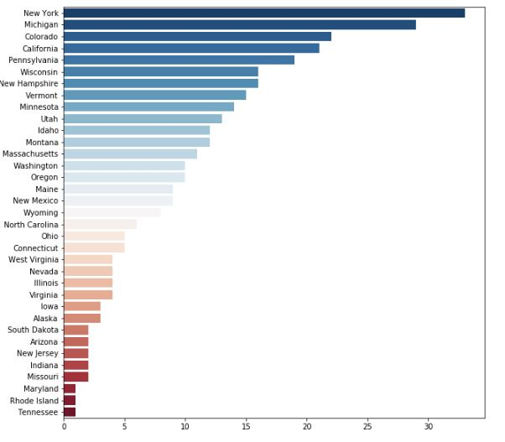
Data and Modeling
We have following data for 330 different resorts:
Name, Region, state, summit_elev, vertical_drop, base_elev, trams, fast Eight, fast Sixes, fast Quads, quad, triple, double, surface, total_chairs, Runs, Terrain Parks, Longest Run_mi, Skiable Terrain_ac, Snow Making_ac, days Open Last Year, years Open, average Snowfall, Adult Weekday, Adult Weekend, projected Days Open, Night Skiing_ac
Resorts from 35 states were included on our data set

Slide 6
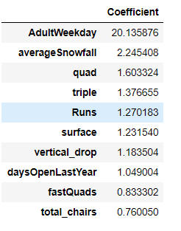
Data and Modeling
Three models were created in this case
X=df.drop(['Name','AdultWeekend','state','Region','summit_elev','base_elev'], axis=1)
y=df.AdultWeekend
scaler = preprocessing.StandardScaler().fit(X)
X_scaled=scaler.transform(X)
y=y.ravel()
X_train, X_test, y_train, y_test = train_test_split(X_scaled, y, test_size=0.25, random_state=1)
lm = linear_model.LinearRegression()
model = lm.fit(X_train,y_train)
y_pred = model.predict(X_test)
print(explained_variance_score(y_test, y_pred))
mean_absolute_error(y_test, y_pred)
Price prediction for the Big Mountain Resort according to the Model:
BM_pred = model. predict (BM_scaled)
print ("The expected June Mountain Resort adult weekend price is $%s " % ' '. join (map (str, BM_pred)))
EVS=0.926
MAE=5.465

Slide 7
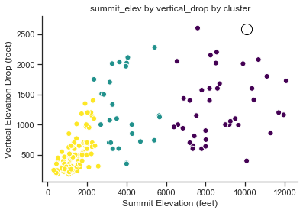
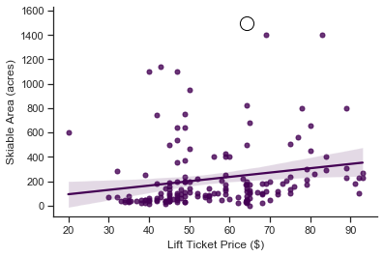
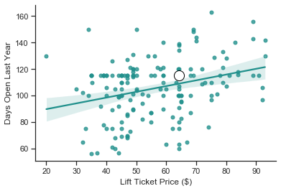
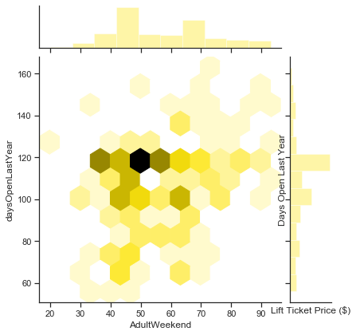
Data and Modeling

Slide 8
Summary
An acceptable size of data set including the 330 resort from 35 states were used for this analysis
Three regression models were created
Weekend adult ticket price was our response variable in all three modes
The best model has explained variance score =0.826 and mean absolute error= 5.426
Suggested ticket price for the Big Mountain resort is $54.70

